Slide 1
August Crop Outlook for Corn, Soybeans, Cotton, and Wheat in Tennessee
August 18, 2021
S. Aaron Smith
Associate Professor and Extension Economist
Department of Agricultural and Resource Economics
University of Tennessee Institute of Agriculture
Ph: 865-210-2024
Email: aaron.smith@utk.edu
Website: https://cropeconomics.tennessee.edu

Slide 2
Key Factors Moving Forward
2021 U.S. yields
China demand / imports
Brazil acres planted / production 2021
Future of the RFS and ethanol
Livestock and poultry demand
Overproduction due to high prices
Climate and weather
Expect volatility
Farm for profitability not price; high input costs will be a major concern for 2022, particularly if commodity prices pull back.

Slide 3
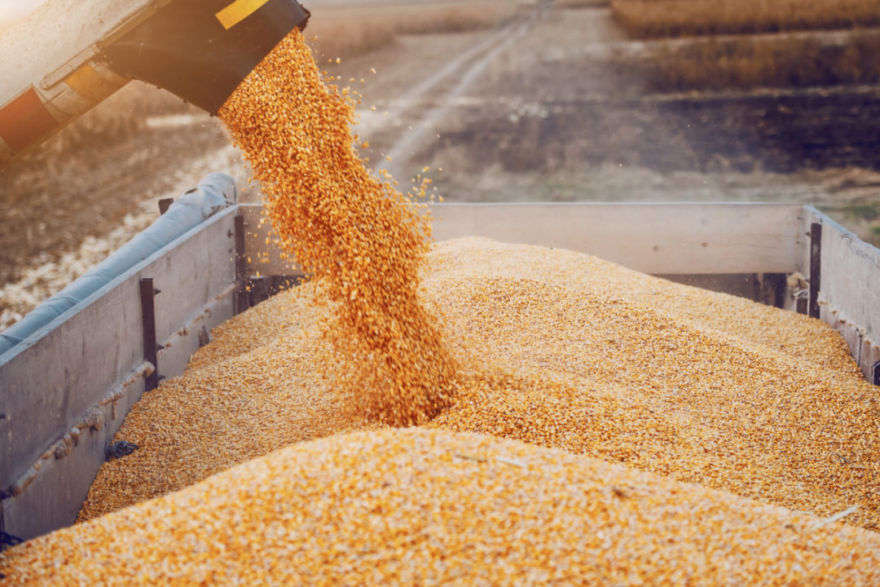
Corn Outlook
Supply, Demand, and Price Update

Slide 4
Global supplies have decreased 4 consecutive years! Projected to rise modestly in 2021. Lower stocks will provide support for prices.

Slide 5
2021 has low opening stocks and significant production uncertainty remains.

Slide 7
Very different growing conditions in the eastern versus the western corn belt. Will have basis and logistical ramifications this fall/winter.

Slide 8
Corn: Crop Progress – August 16, 2021
U.S. good-to-excellent 62% (Projected Yield: 174.6 bu/acre)
North Dakota - 20% (106 bu/acre)
South Dakota – 24% (133 bu/acre)
Minnesota – 35% (166 bu/acre)
Illinois – 74% (214 bu/acre)
Indiana – 72% (194 bu/acre)
Ohio – 81% (193 bu/acre)
Tennessee – 79% (173 bu/acre)

Slide 9
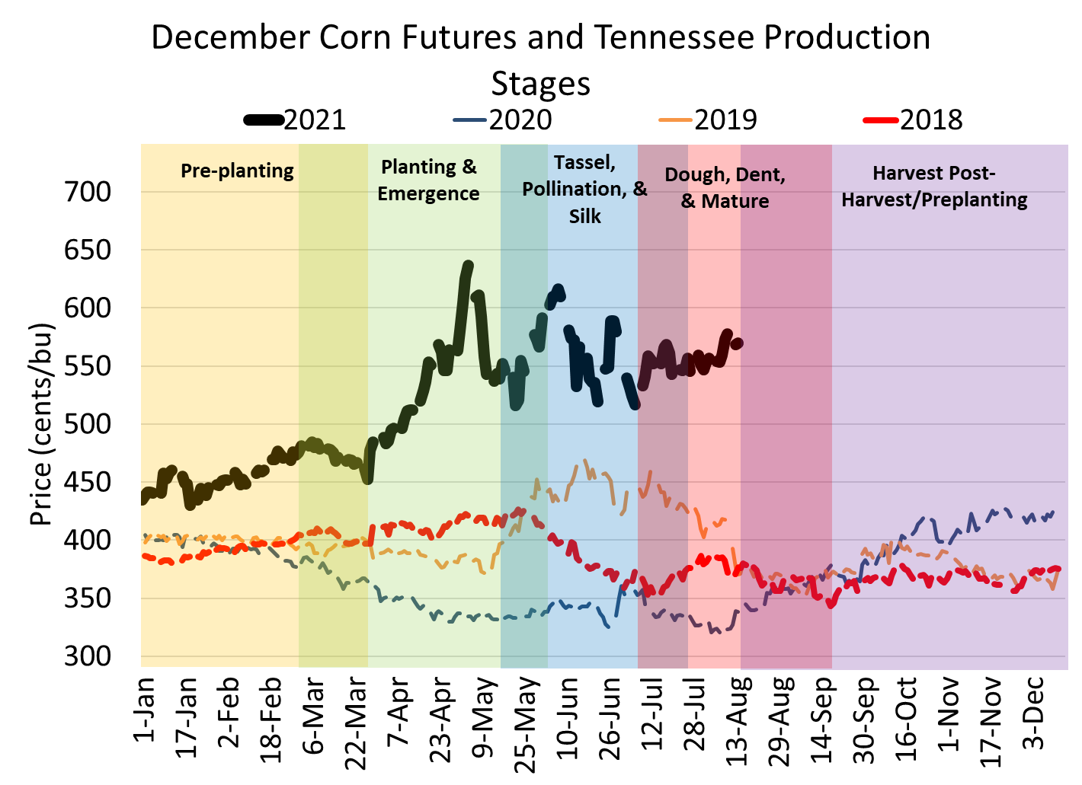
2020 prices rallied starting mid August and carried through into 2021. Fueled by China purchases the derecho and flash drought.
2021 prices have been strongly influenced by drought, US export sales pace, and weather/frost in Brazil.
Extreme volatility in markets April-July 2021.

Slide 10
Producer terminal markets (poultry, feed mills, etc) may have higher basis offerings than reported by elevators and barge points.

Slide 11
2021/22:
National MYA Price Range $4.25-$6.00
2021: 8.48%

Slide 12
Corn - Net Return Table ($/acre); $710/acre CoP
 |  | Yield (bu/acre)
 |  | 120 | 130 | 140 | 150 | 160 | 170 | 180 | 190 | 200 | 210 | 220
 | 4.00 | (230) | (190) | (150) | (110) | (70) | (30) | 10 | 50 | 90 | 130 | 170
 | 4.25 | (200) | (158) | (115) | (73) | (30) | 13 | 55 | 98 | 140 | 183 | 225
 | 4.50 | (170) | (125) | (80) | (35) | 10 | 55 | 100 | 145 | 190 | 235 | 280
 | 4.75 | (140) | (93) | (45) | 3 | 50 | 98 | 145 | 193 | 240 | 288 | 335
 | 5.00 | (110) | (60) | (10) | 40 | 90 | 140 | 190 | 240 | 290 | 340 | 390
 | 5.25 | (80) | (28) | 25 | 78 | 130 | 183 | 235 | 288 | 340 | 393 | 445
 | 5.50 | (50) | 5 | 60 | 115 | 170 | 225 | 280 | 335 | 390 | 445 | 500
Price | 5.75 | (20) | 38 | 95 | 153 | 210 | 268 | 325 | 383 | 440 | 498 | 555
($/bu) | 6.00 | 10 | 70 | 130 | 190 | 250 | 310 | 370 | 430 | 490 | 550 | 610
 | 6.25 | 40 | 103 | 165 | 228 | 290 | 353 | 415 | 478 | 540 | 603 | 665
 | 6.50 | 70 | 135 | 200 | 265 | 330 | 395 | 460 | 525 | 590 | 655 | 720
 | 6.75 | 100 | 168 | 235 | 303 | 370 | 438 | 505 | 573 | 640 | 708 | 775
 | 7.00 | 130 | 200 | 270 | 340 | 410 | 480 | 550 | 620 | 690 | 760 | 830
 | 7.25 | 160 | 233 | 305 | 378 | 450 | 523 | 595 | 668 | 740 | 813 | 885
 | 7.50 | 190 | 265 | 340 | 415 | 490 | 565 | 640 | 715 | 790 | 865 | 940
 | 7.75 | 220 | 298 | 375 | 453 | 530 | 608 | 685 | 763 | 840 | 918 | 995

Slide 13
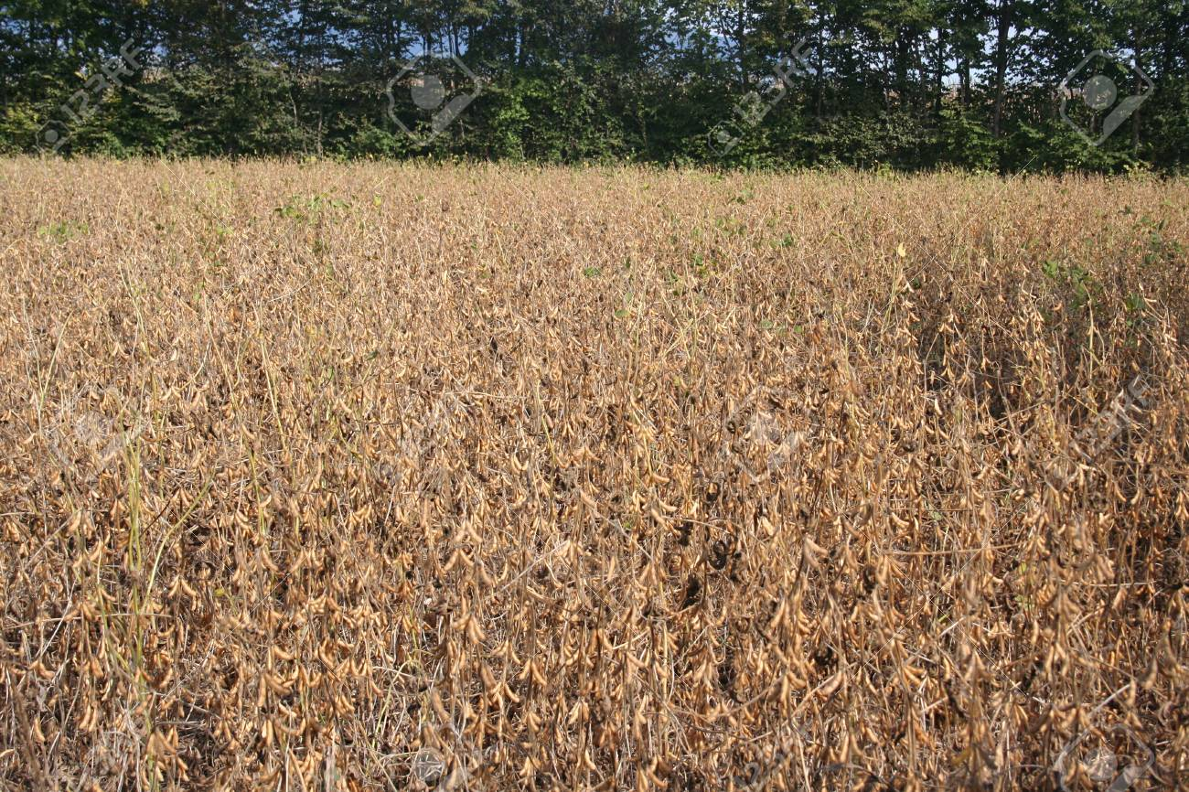
Soybean Outlook
Supply, Demand, and Price Update

Slide 14
Global supplies have decreased two years, prior to a modest increase in 2021. Last year Brazil had a record soybean crop. What will 2021 bring?

Slide 15
US supplies have dropped dramatically after the trade dispute with China was resolved. 2021 projected US stocks would be functionally out.

Slide 16
US exports expected down, mostly due to lower stocks. Share of global exports has rebounded since 2019, but the US has lost market share over the past 5-years.

Slide 17
Slight differences in production maps compared to corn.

Slide 18
Soybean: Crop Progress – August 16, 2021
U.S. good-to-excellent 57% (Projected Yield: 50 bu/acre)
North Dakota - 14% (24 bu/acre)
South Dakota – 22% (39 bu/acre)
Minnesota – 29% (43 bu/acre)
Illinois – 71% (64 bu/acre)
Indiana – 68% (60 bu/acre)
Ohio – 73% (58 bu/acre)
Tennessee – 73% (49 bu/acre)

Slide 19
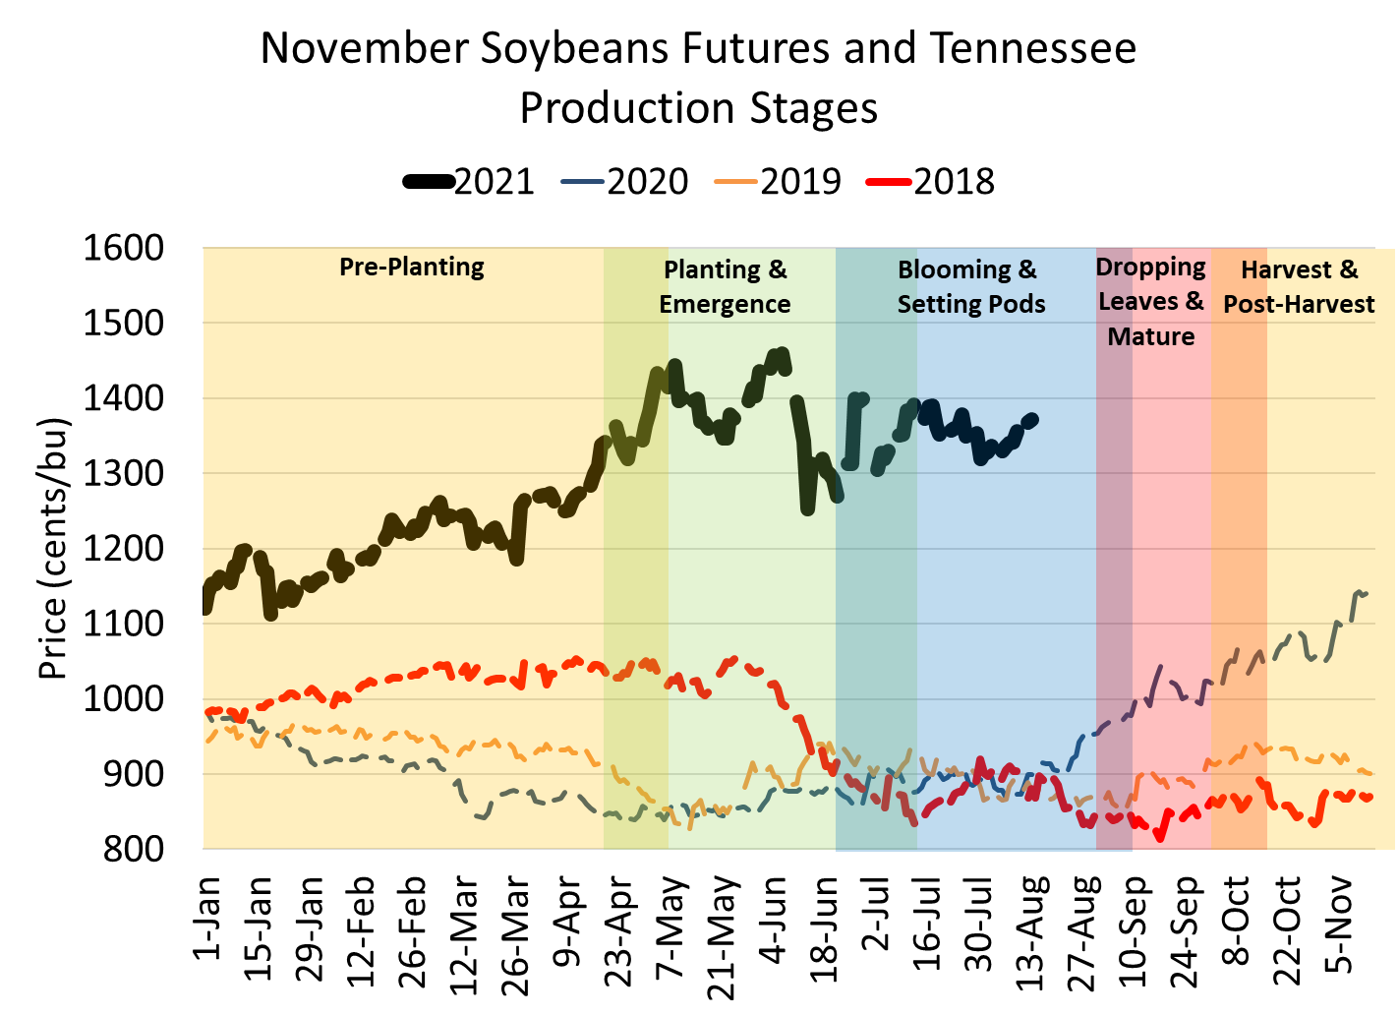
Strong global demand and tight US stocks.
Drought in the northern plains.
What will Brazil plant?

Slide 20
No major instate crushers for soybeans. Most Tennessee soybeans are sent to export markets (River Terminals) or out of state crush facilities.

Slide 21
2021/22:
National MYA Price Range $10.25-$14.00
2021: 3.2%

Slide 22
Soybean - Net Return Table ($/acre); $580/acre CoP
 |  | Yield (bu/acre)
 |  | 25 | 30 | 35 | 40 | 45 | 50 | 55 | 60 | 65 | 70 | 75
 | 11.00 | (305) | (250) | (195) | (140) | (85) | (30) | 25 | 80 | 135 | 190 | 245
 | 11.25 | (299) | (243) | (186) | (130) | (74) | (18) | 39 | 95 | 151 | 208 | 264
 | 11.50 | (293) | (235) | (178) | (120) | (63) | (5) | 53 | 110 | 168 | 225 | 283
 | 11.75 | (286) | (228) | (169) | (110) | (51) | 8 | 66 | 125 | 184 | 243 | 301
 | 12.00 | (280) | (220) | (160) | (100) | (40) | 20 | 80 | 140 | 200 | 260 | 320
 | 12.25 | (274) | (213) | (151) | (90) | (29) | 33 | 94 | 155 | 216 | 278 | 339
 | 12.50 | (268) | (205) | (143) | (80) | (18) | 45 | 108 | 170 | 233 | 295 | 358
Price | 12.75 | (261) | (198) | (134) | (70) | (6) | 58 | 121 | 185 | 249 | 313 | 376
($/bu) | 13.00 | (255) | (190) | (125) | (60) | 5 | 70 | 135 | 200 | 265 | 330 | 395
 | 13.25 | (249) | (183) | (116) | (50) | 16 | 83 | 149 | 215 | 281 | 348 | 414
 | 13.50 | (243) | (175) | (108) | (40) | 28 | 95 | 163 | 230 | 298 | 365 | 433
 | 13.75 | (236) | (168) | (99) | (30) | 39 | 108 | 176 | 245 | 314 | 383 | 451
 | 14.00 | (230) | (160) | (90) | (20) | 50 | 120 | 190 | 260 | 330 | 400 | 470
 | 14.25 | (224) | (153) | (81) | (10) | 61 | 133 | 204 | 275 | 346 | 418 | 489
 | 14.50 | (218) | (145) | (73) | 0 | 73 | 145 | 218 | 290 | 363 | 435 | 508
 | 14.75 | (211) | (138) | (64) | 10 | 84 | 158 | 231 | 305 | 379 | 453 | 526

Slide 23
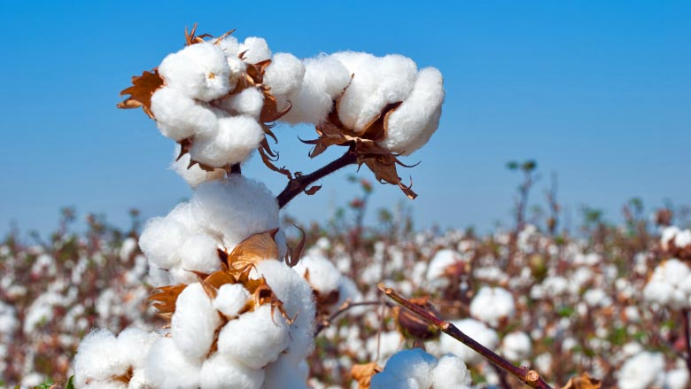
Cotton and Wheat
Price Update

Slide 24
Tennessee Cotton: Crop Progress
Tennessee cotton crop is 2.5-3.5 weeks behind normal.
Could be yield limiting.
Makes it more susceptible to adverse harvest weather.
Cotton Tour Sept 1.

Slide 25
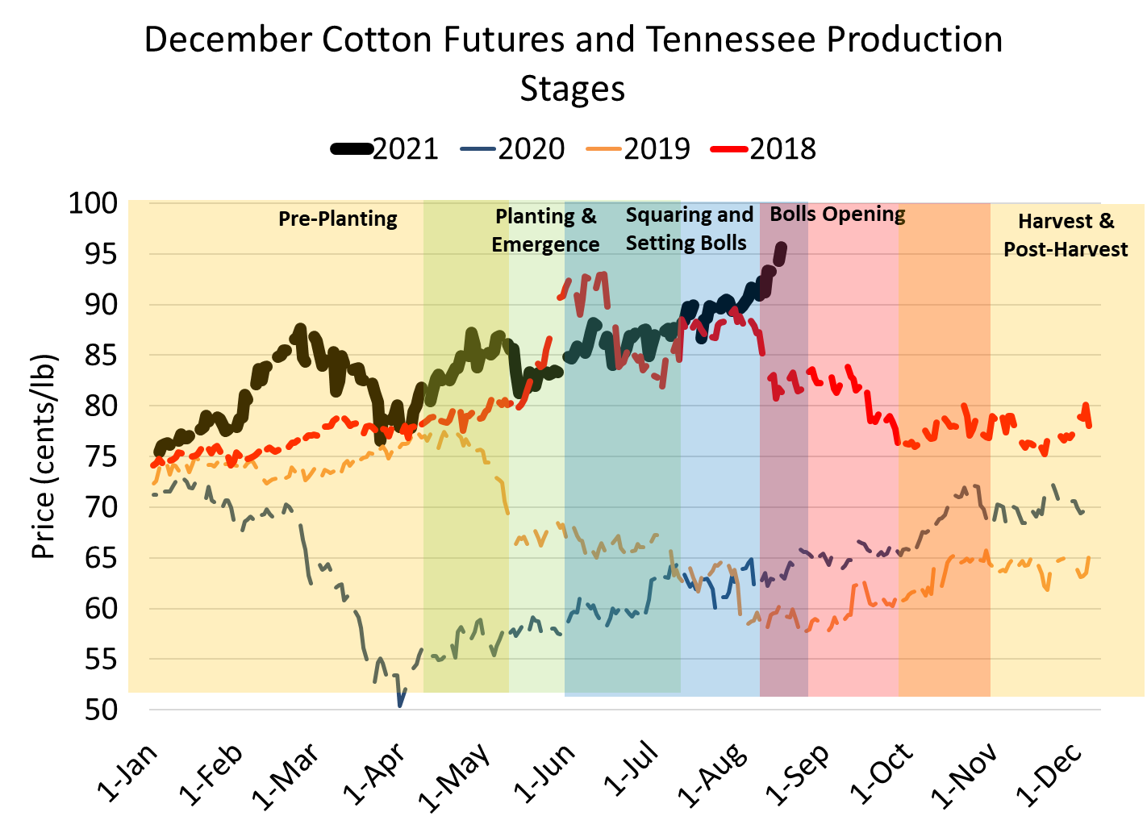
April 2020 cotton prices were near 50 cents, this winter prices have a chance of hitting $1.
Extended periods with cotton over 95 cents may lead to long term demand erosion and market share replacement with synthetic fibers.

Slide 26
2021/22:
MYA Price Range $0.65-$0.87
2021: 17.2%

Slide 27
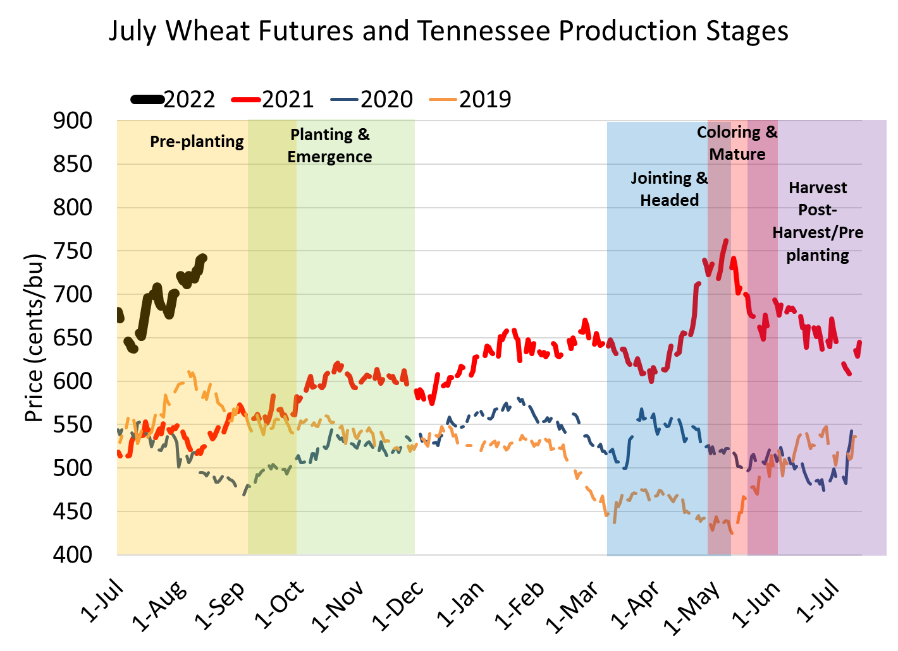
Incentive to plant wheat this fall.
Downside price protection should be considered.
Nearby wheat futures have had periods of above $7.00 5 times in the last 20 years.

Slide 28
2021/22:
MYA Price Range $5.25-$7.10
2021: 30.4%

Slide 29
Price Projections
 | Harvest Futures (2021) as at August 17 | WASDE (Aug21) 2021/22 National MYA Price | Harvest Futures (2022) as at August 17 | Projected Tennessee Cash 21/22 MYA
Corn | $5.63 | $5.75 | $5.12 | $5.50-$7.50
Soybeans | $13.59 | $13.70 | $12.59 | $12.00-$14.50
Cotton | 94.50 | 80 | 83.68 | 82-92
Wheat | - | $6.70 | $7.25 | $6.50-$7.75

Slide 30
Marketing Considerations
Straight short hedge requires margin/liquidity.
Options strategies can remove downside risk and/or allow upside participation in futures market rallies.
Basis and storage are the most impactful marketing tools available to Tennessee producers.
Identifying terminal markets for producers in the county/region can increase price premiums.
Its not too early to look at 2022 crop pricing. Does it make sense to take some price risk off the table?
Wheat: Jul 2022 put option for $6.50 costs 24 cents.
Corn: Dec 2022 put option for $4.50 costs 20 cents.
Soybeans: Nov 2022 put option for $11.20 costs 28 cents.
Cotton: Dec 2022 put option for 75 costs 4.16 cents.

Slide 31
Thank you
S. Aaron Smith
Associate Professor and Extension Economist
Department of Agricultural and Resource Economics
University of Tennessee Institute of Agriculture
Ph: 865-210-2024
Email: aaron.smith@utk.edu
Website: https://cropeconomics.tennessee.edu

